Slide 1
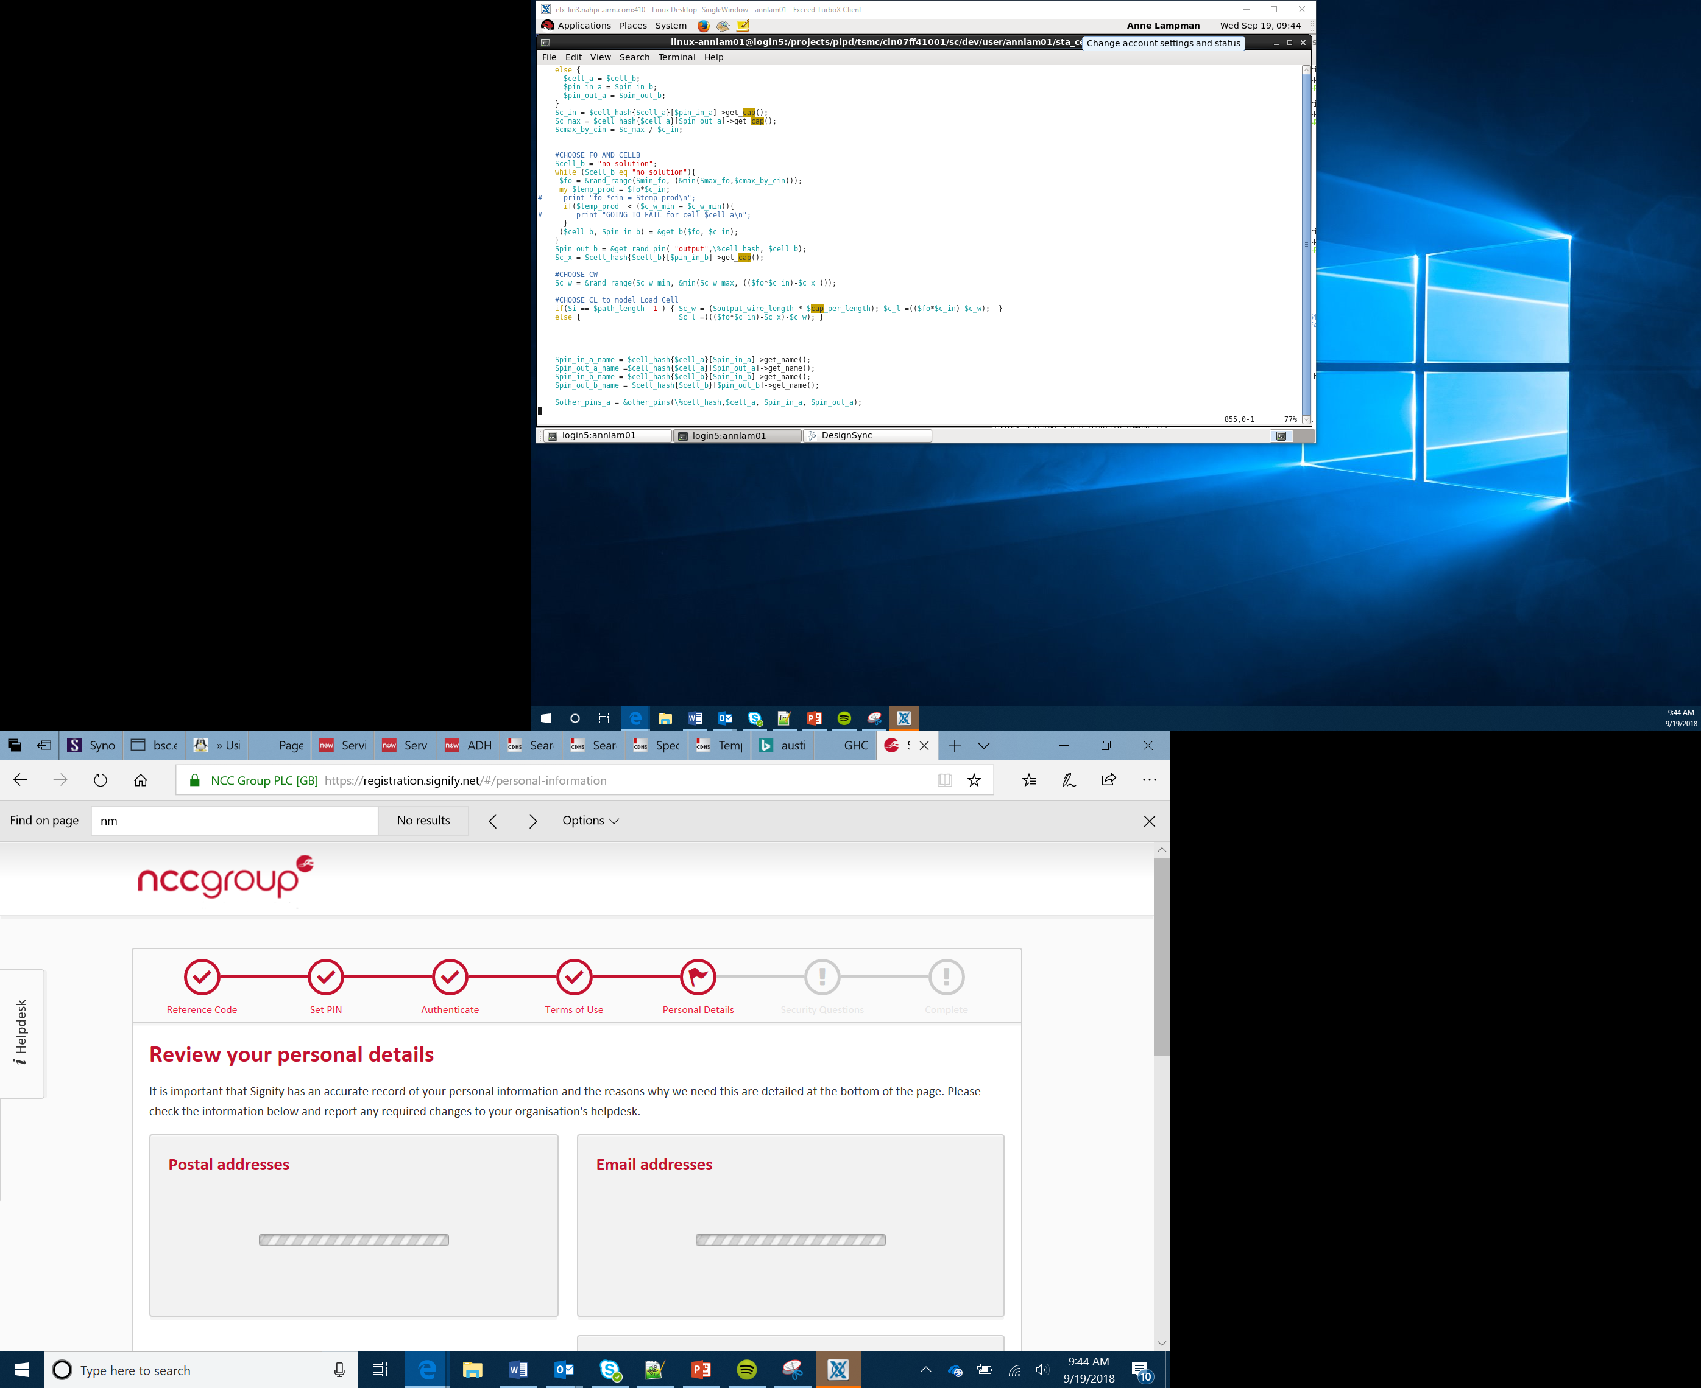

Internet of Things
Lesson 2

Slide 2
The Input Process Output (IPO) Model
All computer systems take data into a system using Inputs, carry out processes on the inputs and then display the result of that processing using Outputs
Using the Input Process Output worksheet try to identify what the outputs will be
Input
Process
Output
Notes:
Introduce the concept of Input Process Output (IPO). The IPO model takes inputs from peripherals such as keyboards, these inputs are then process and the result of the processing is displayed on an output device such as a screen.

Slide 3
Input, Process, Output (IPO)
Input
Process
Output
Sensors (produce data)
Temperature sensor
Light sensor
Accelerometer
Microphone
Camera
Wi-Fi
Bluetooth
Takes input data
Does something with the data
Stores the data
Transmits the data
Motors/servos
LEDs (micro:bit screen)
Sound
Wi-Fi
Bluetooth
Notes:
The concept of IPO and IoT has now been covered. The two should now be connected together. Give a brief overview of the different input and output devices that could be used by IoT connected devices.

Slide 4





Embedded systems
Anything with a processor in it!
Examples of embedded systems:
Cars
TVs
Games consoles
Printers
Cameras
Wearables
Micro:bit

Slide 5
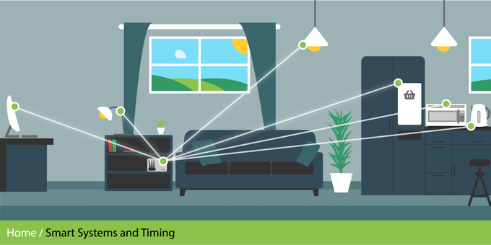
What is IoT?
Internet of Things (IoT)
Adding electronics to everything
Electronics such as:
Sensors (cameras, temp, light, humidity etc.)
Microprocessors (like the micro:bit)
Screens
Everything can link to the internet/each other
Anything electronic can be controlled
Can stream data continuously
Notes:
Introduce the concept of the IoT. This allows a wide range of household object to communicate with each other. They use sensors, microprocessors and screens. They allow all of the different items to link together and communicate with each other. You could give the example of a connected light bulb. This could be turned on and off from a mobile telephone. You could change the colour, brightness, set up timings all from the mobile phone.

Slide 6








Example: IoT
IoT devices typically have:
Sensors
CPU
Radio
Security
Connectivity
Services
Notes:
Internet of things devices will need to be contain a number of different elements to work. Learners will find the technical nature of the terminology but it is worth providing a brief overview. They will need sensors to be able to detect things in the outside world. You could use the example of the accelerometer and compass that is built into the micro:bit. They will need an MCU (microprocessor control unit). An example of this is the micro:bit. They will need radio so that they communicate with other devices wirelessly. They need security to stop other people from connecting to them that don’t have permission to do so. They need to be able to connect with other devices for example a light bulb connecting to a mobile telephone. They also need services i.e. they need to do something when you connect to them e.g. turning the light bulb on and off.

Slide 7
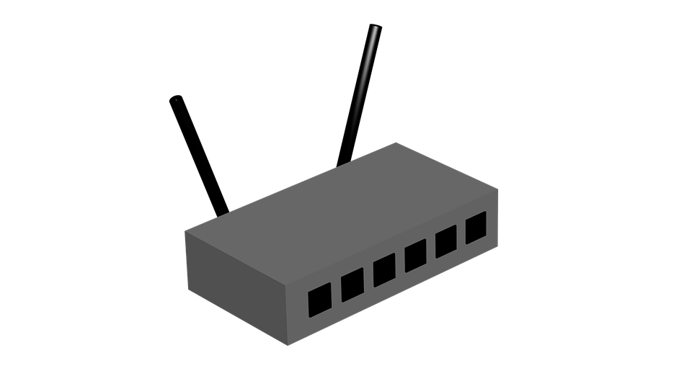

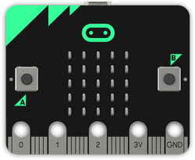
How IoT works
Long range (up to 50km)
Sensors
GATEWAY
(to the internet)
Data scientists use the data to make decisions
3/4/5G
WiFi
LoRa
Sigfox
NODE
Notes:
Node transmits to gateway over a long range using 3G (mobile network) or LoRa/SigFox
Gateway receives data and then transmits it to the internet
The data scientists receive the data on a PC or mobile device

Slide 8
Internet of Things – Example of Devices
The Internet of Things (IoT) allows a wide range of household devices that can be connect to the internet
Some washing machines can be connected to the internet
What could the advantages be of doing this?
Using the Internet of Things (IoT) worksheet choose a household object of your choice. Quickly sketch out the object and highlight what facilities could be offered by connecting it to the internet
If you have time, can you think of any disadvantages?
Notes:
Learners should now have an initial understanding of the IoT. They should now be creative and start to think about how the IoT could be used to control a number of household devices. A washing machine could be controlled by a mobile phone. You could start the washing machine away from home so that when you return it is finished and ready to be removed. You could check the status of the wash, change settings such as temperature. Use questioning to allow learners to be creative as possible. They may identify that there could be a problem if internet access went down. This may mean that the washing machine couldn’t be used if there was no access. This could be overcome through having backup controls on the actual device. Learners should now choose their own device, encourage creativity.

Slide 9
Summary
All computer systems use the IPO model
The IoT is a range of objects which contain a computer to allow them to connect to the internet
There are many advantages offered through connecting devices to the internet
There are potential issues with security as IoT devices often have less security and antivirus software than traditional computers

